Slide 1
Compiler
An Introduction to Lex

Slide 2
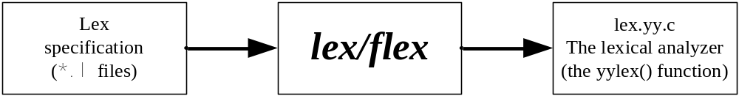
What is Lex
A lexical analyzer generator
  Read characters and translate to token
  Read rules from a specification file (*.l file)
  Generate the lexical analyzer in C language

Slide 3
The First Impression
The structure of a lex program – three sections
  Definition section: any initial C/C++ codes or lex definitions
  Rules section: pattern + action, separated by whitespaces
  Subroutine section: any legal C or C++ codes
Two sections are separated by a “%%” line
… Definition Section …
%%
… Rules Section …
%%
… Subroutine Section …

Slide 4
The Simplest Lex Program
The lex code
%{
unsigned int charCount=0, wordCount=0, lineCount=0;
%}
word [^ \t\n]+
eol \n
%%
{word} { wordCount++; charCount += yyleng; }
{eol} { charCount++; lineCount++; }
. charCount++;
%%
int main(int argc, char *argv[]) {
yylex();
printf("%u %u %u\n", lineCount, wordCount, charCount);
return(0);
}

Slide 5
Practice 1
Using nano editor to create input.txt with following content.
This is an apple.

Slide 6
Practice 1
Compile and Run the Program
How to compile?
Run the program
$ flex –o lex.yy.c wordcount.l
$ gcc –o wordcount lex.yy.c -lfl
$ cat input.txt | ./ wordcount
$ ./ wordcount < input.txt

Slide 7
The Definition Section
Define C/C++ codes and Abbreviations
Initial C or C++ codes enclosed with %{ and %}
%{
unsigned int charCount=0, wordCount=0, lineCount=0;
%}
word [^ \t\n]+
eol \n
%%
…
%%
…
}
Lex definitions :
Token name and corresponding REs that separated by whitespaces

Slide 8
The Rules Section
The rules used by yylex() function
Action:
C/C++ statement or lex macro
Separated by whitespaces
…
%%
{word} { wordCount++; charCount += yyleng; }
{eol} { charCount++; lineCount++; }
. charCount++;
%%
…
Pattern:
Can be a token or RE
Predefine token enclosed with { and }
Following two are different:
%%
.|\n ECHO;
%%
%%
. |
\n ECHO;
%%

Slide 9
The Rule Section (Cont’d)
If C/C++ codes are more than one statements or span multiple lines, it can be enclosed in braces { }.
  .|\n printf(“rule1”); char_count++;
  .|\n { printf(“rule1”); char_count++; }
If a pattern matches, the associated actions are executed
We are allowed to use return in actions
  Interrupt the yylex() analyzer with the returned value
  The analyzer resumes when yylex() is called next time
Same

Slide 10
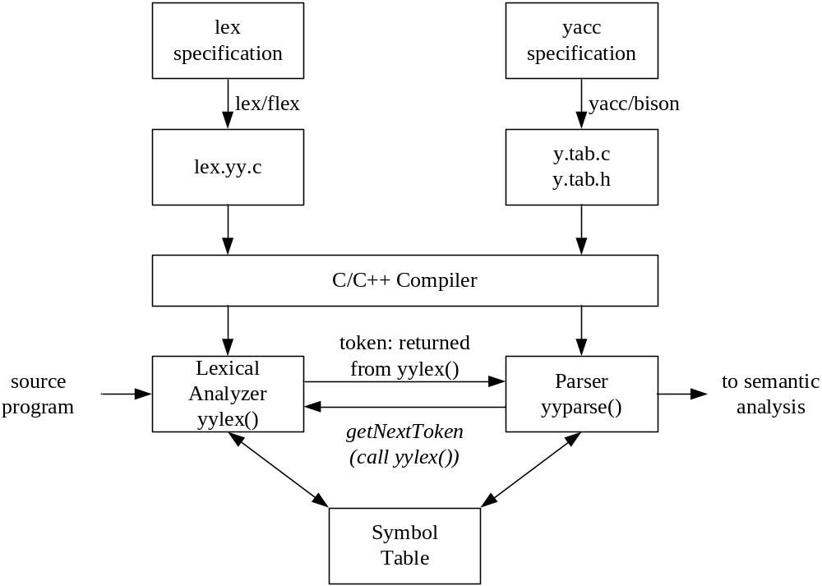
The Use of yylex()

Slide 11
Lex Matching Rules
Match the token with longest match
  Input: abc
  Rule: [a-z]+
  The “abc” will be treated as a token
Use the first applicable rule
  Input: test
  Rules:
  test { printf(“rule 1”); }
  [a-z]+ { printf(“rule 2”); }
  It will print “rule 1”

Slide 12
Lex Matching Pattern – REs
RE | Purpose
. | Matches any single character except \n.
* | Matches zero or more occurrence of the preceding RE. Bo* -> B, Bo
+ | Matches one or more occurrence of the preceding RE Bo+ -> Bo, Boo, Booo
? | Matches zero or one occurrence of the preceding RE Bo? -> B, Bo
[] | Matches a character listed in brackets. If the first character is a circumflex (^), it inverses the meaning to match a not listed character. This is also called a character class. [abc] -> a, b, c [_a-z] -> a, b, …, z [^abc] -> 非a, b, c
^ | Matches the beginning of a line
$ | Matches the end of a line

Slide 13
Lex Matching Pattern – REs (Cont’d)
RE | Purpose
| | Matches either the preceding RE or the following RE a|b -> a, b (a|b is equal to [ab])
\ | The escape character. \. -> .
{} | Indicate how many times the preceding pattern is allowed to match. {times-lower-bound[,times-upper-bound]} ok{2} -> okok ok{2,} -> okokok ok{2,3} -> okokok
“…” | Interprets everything within the quotation marks literally “int” -> int
() | Group a series of REs together into a new RE (abc|ABC) -> abc, ABC (abc|ABC) + -> abcABCabc

Slide 14
Practice 2
%{
unsigned int charCount=0, wordCount=0, lineCount=0;
%}
digit [0-9]
%%
{digit} { ECHO; printf(“ is digit.\n”); }
%%
int main(int argc, char *argv[]) {
yylex();
return(0);
}
digits [0-9]+ , {digit}+
integer [+-]?{digits}
float {digits}\.{digits}
letter [a-zA-Z_]
identifier {letter}({letter}|{digit})*

Slide 15
How to write comments rule
Identify C-like comments /* … */
INITIAL state
Start state
%x COMMENT
%%
"/*" {BEGIN COMMENT;}
<COMMENT>.|\n {/* do nothing */}
<COMMENT>"*/" {BEGIN INITIAL;}
.|\n {ECHO;}
%%
int main(void) {
yylex();
return(0);
}

Slide 16
Match with Start States
Limit the scope of rules
  A rule can be limited to be available only in a start state
Start states are defined in the definition section
  %s state-name: Define a regular start state
  %x state-name: Define a exclusive start state

Slide 17
More on Start States
Lex starts with a regular INITIAL start state
  start state = INITIAL
Start state can be switched using the BEGIN macro in actions
When lex is in a regular start state
  Rules with the INITIAL state or the matched state are both used for matching
When lex is in an exclusive start state
  Only rules with the matched state are used for matching

Slide 18
Common Lex Variables
yyout
  The FILE* used for output, it is equivalent to stdout by default
yyin
  The FILE* used for read input, it is equivalent to stdin by default
yytext
  Store the matched token
yyleng
  Store the length of the matched token

Slide 19
Common Lex Macros
ECHO
  It is equivalent to fprintf(yyout, “%s”, yytext)
  An example: ECHO;
BEGIN
  Switch the start state
  An example: BEGIN INITIAL;

Slide 20
Practice2
Add ‘comment’ to “word_count.l”
Compile and run the analyzer
$ flex –o lex.yy.c word_count.l $ gcc –o simple lex.yy.c –lfl $ ./simple < /etc/passwd

